Slide 1
OUTLINE
CENG 3005 Database Management Systems Week 6
SQL
Ordering
Set Operations
Inner Join/Left Outer Join/Right Outer Join/Full Join
Aggregate Functions
Modifying the database (Delete/Insert/Update)
Views
Stored procedures
Functional Dependencies
Normal Forms

Slide 2
Ordering the Display of Tuples: Order by
List in alphabetic order the names of all customers having a loan in Perryridge branch
select distinct customer_name from borrower b, loan l where b.loan_number = l.loan_number and branch_name = 'Perryridge' order by customer_name
Specify desc for descending order or asc for ascending order, for each attribute; ascending order is the default.
Example: order by customer_name desc

Slide 3
SQL
Ordering
Set Operations
Inner Join/Left Outer Join/Right Outer Join/Full Join
Aggregate Functions
Modifying the database (Delete/Insert/Update)
Views
Stored procedures
Functional Dependencies
Normal Forms

Slide 4
Set Operations
The set operations union, intersect, and except operate on relations and correspond to the relational algebra operations ∪, ∩, −.
Each of the above operations automatically eliminates duplicates; to retain all duplicates use the corresponding multiset versions union all, intersect all and except all. Suppose a tuple occurs m times in r and n times in s, then, it occurs:
m + n times in r union all s
min(m,n) times in r intersect all s
max(0, m – n) times in r except all s

Slide 5
Set Operations
Find all customers who have a loan, an account, or both:
(select customer_name from depositor) union (select customer_name from borrower)
Find all customers who have both a loan and an account.
(select customer_name from depositor) intersect (select customer_name from borrower)
Find all customers who have an account but no loan.
(select customer_name from depositor) except (select customer_name from borrower)

Slide 6
SQL
Ordering
Set Operations
Inner Join/Left Outer Join/Right Outer Join/Full Join
Aggregate Functions
Modifying the database (Delete/Insert/Update)
Views
Stored procedures
Functional Dependencies
Normal Forms

Slide 7
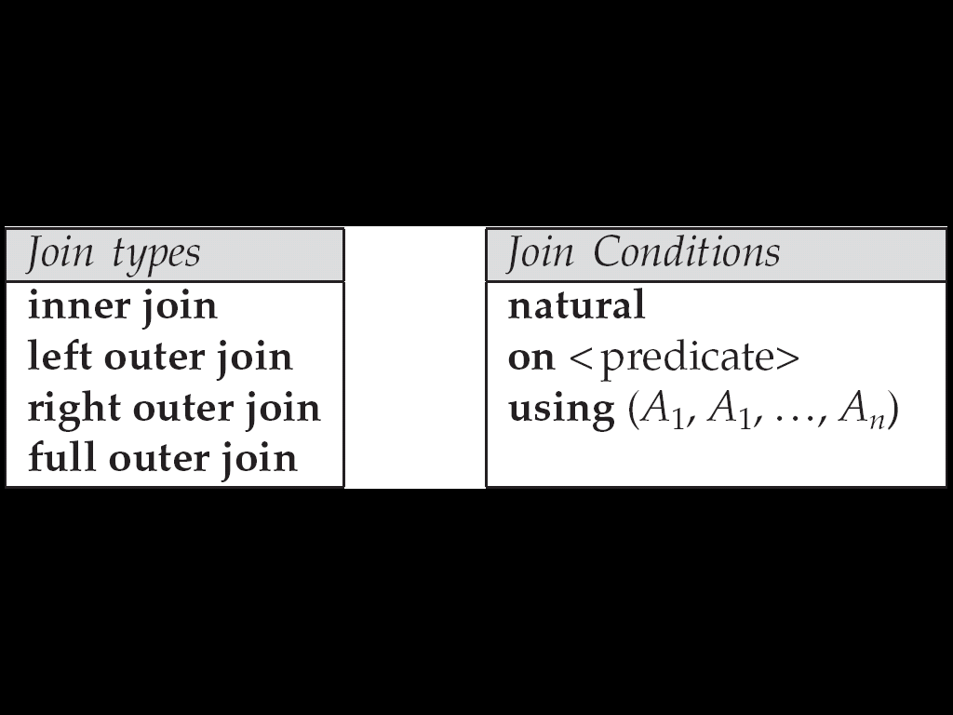
Joined Relations**
Join operations take two relations and return as a result another relation.
These additional operations are typically used as subquery expressions in the from clause
Join condition – defines which tuples in the two relations match, and what attributes are present in the result of the join.
Join type – defines how tuples in each relation that do not match any tuple in the other relation (based on the join condition) are treated.

Slide 8
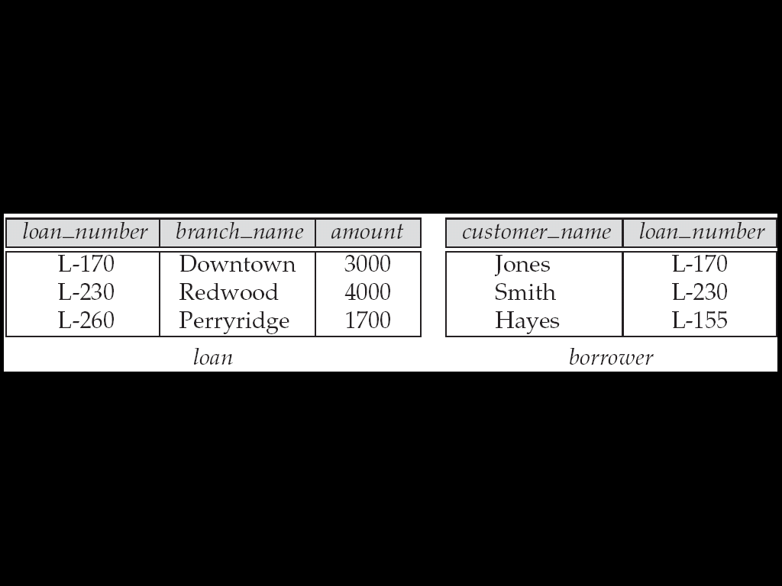
Joined Relations – Datasets for Examples
Note: borrower information missing for L-260 and loan information missing for L-155

Slide 9
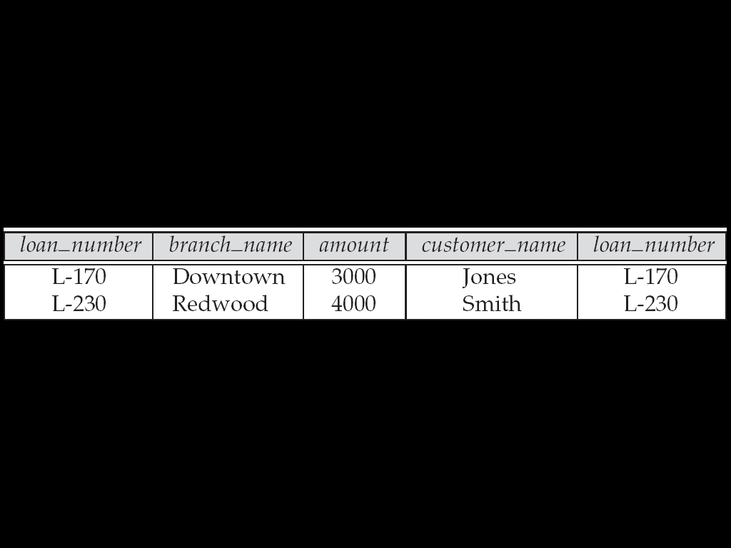
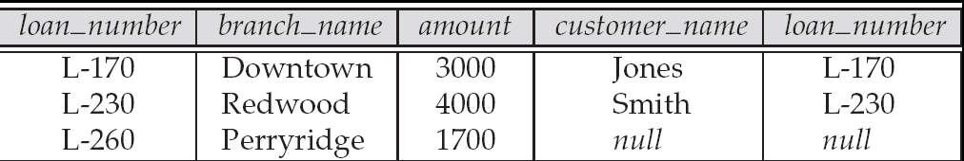
Joined Relations – Examples
Select *
from loan inner join borrower on
loan.loan_number = borrower.loan_number
Select *
from loan left outer join borrower on loan.loan_number = borrower.loan_number

Slide 10
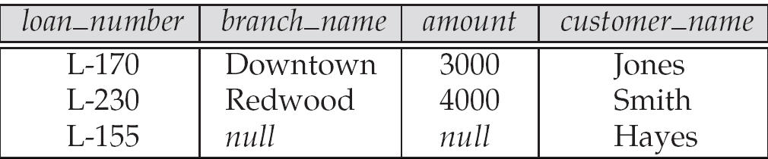
Joined Relations – Examples
Select * from loan natural inner join borrower on loan.loan_number = borrower.loan_number
Select * from loan natural right outer join borrower on loan.loan_number = borrower.loan_number
Find all customers who have either an account or a loan
(but not both) at the bank.
select customer_name from (depositor natural full outer join borrower ) where account_number is null or loan_number is null

Slide 11
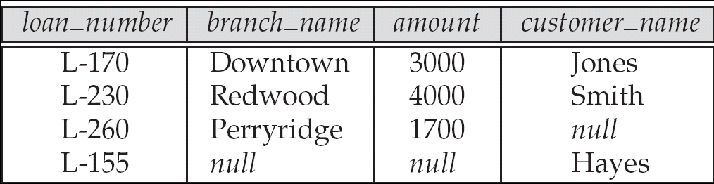
Joined Relations – Examples
Natural join can get into trouble if two relations have an attribute with the same name that should not affect the join condition
e.g. an attribute named description may be present in many tables
Solution:
loan full outer join borrower using (loan_number)

Slide 12
Derived Relations
SQL allows a subquery expression to be used in the from clause
Find the average account balance of those branches where the average account balance is greater than $1200.
select branch_name, avg_balance from
(select branch_name, avg (balance) from account group by branch_name ) as branch_avg ( branch_name, avg_balance ) where avg_balance > 1200
Note that we compute the temporary (view) relation branch_avg in the from clause, and the attributes of branch_avg can be used directly in the where clause.

Slide 13
SQL
Ordering
Set Operations
Inner Join/Left Outer Join/Right Outer Join/Full Join
Aggregate Functions
Modifying the database (Delete/Insert/Update)
Views
Stored procedures
Functional Dependencies
Normal Forms

Slide 14
Aggregate Functions
These functions
operate on the multiset of values of a column of a table
and
return a value
avg: average value min: minimum value max: maximum value sum: sum of values count: number of values

Slide 15
Aggregate Functions (Cont.)
Find the average account balance at the Perryridge branch.
select avg (balance) from account where branch_name = 'Perryridge'
Find the number of tuples in the customer relation.
select count (*) from customer
Find the number of depositors in the bank.
select count (distinct customer_name) from depositor

Slide 16
Aggregate Functions – Group By
Find the number of depositors for each branch.
select branch_name, count (distinct customer_name) from depositor, account where depositor.account_number = account.account_number group by branch_name
Note: Attributes in select clause outside of aggregate functions must appear in group by list

Slide 17
SQL
Ordering
Set Operations
Inner Join/Left Outer Join/Right Outer Join/Full Join
Aggregate Functions
Modifying the database (Delete/Insert/Update)
Views
Stored procedures
Functional Dependencies
Normal Forms

Slide 18
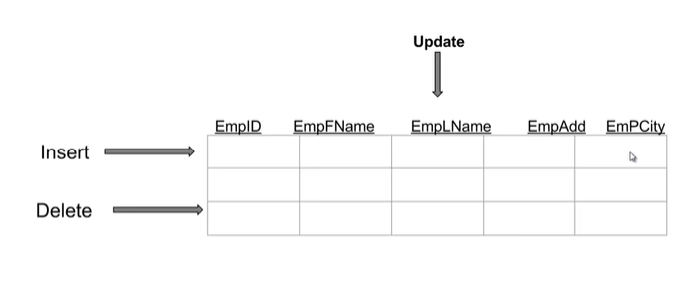
Modifying the Database

Slide 19
